Slide 1
AB 901 Implementation Steven Sander Project Lead CalRecycle

Slide 2
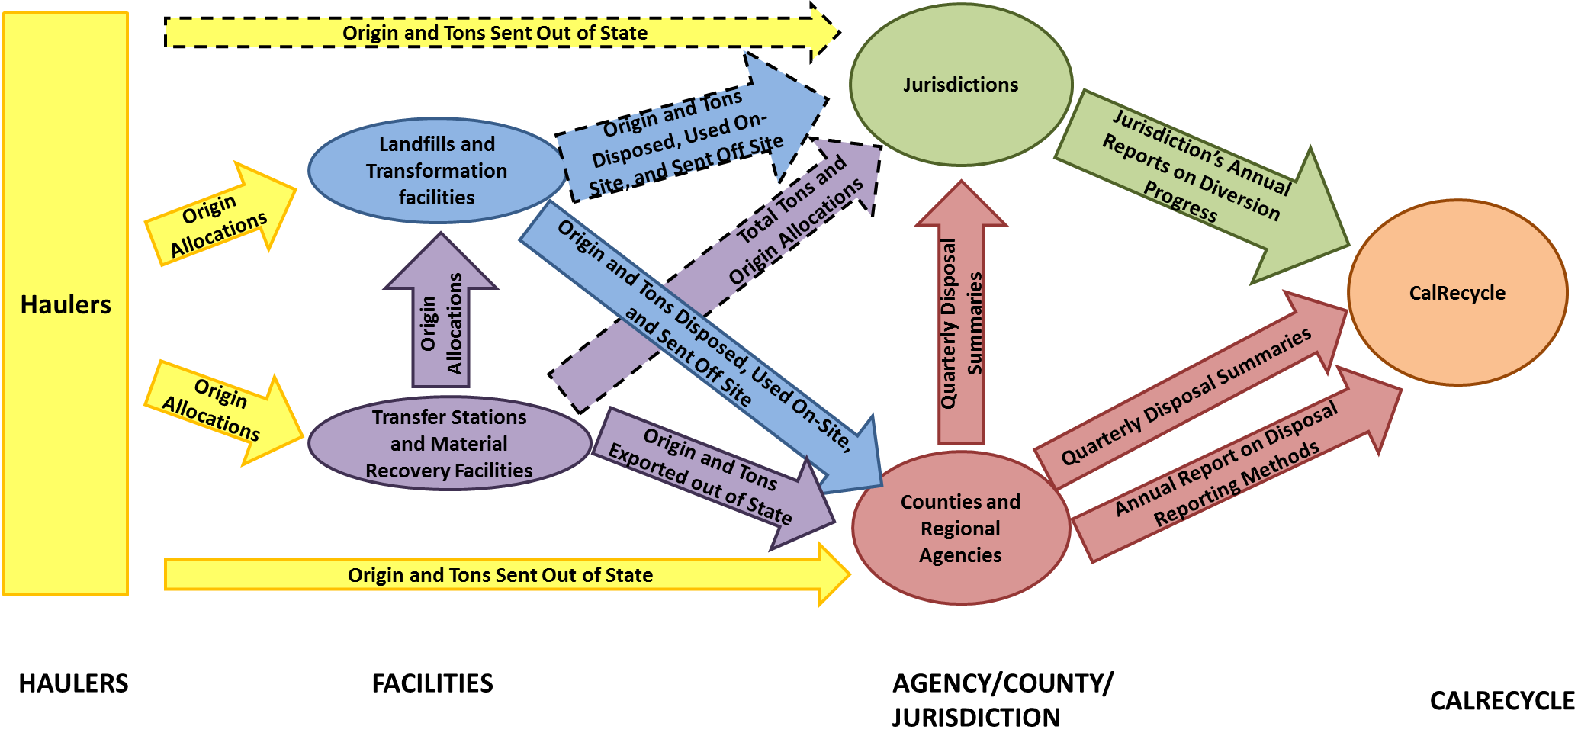
Current Disposal Reporting System

Slide 3
AB 901

Slide 4
Currently, only permitted solid waste facilities report to counties and regional agencies the total tons sent to disposal by jurisdiction of origin as well as a few other data points
AB 901 widens the reporting requirements to require reporting on the flow of recyclable/compostable materials by material type by recyclers and composters, as well as exporters, transporters, brokers, and food waste self-haulers (under AB 1103).
AB 901 provides for enforcement by the Department for late reporting and mis-reporting data.
Expanded reporting requirements will enable the state to perform much more detailed analyses of both waste and recycling flows, enabling better evidence-based policy-making by the Department
Scope and Purpose of AB 901

Slide 5
AB 901 Timeline: The Process So Far
Chaptered 10/10/2015
Informal Rulemaking Process: 2016-2017
Formal Rulemaking Process (Jan 26, 2018—present)
7th draft regulations released October 1, 2018 – comment period closed 8/16/2018
Current Status: Reviewing comments

Slide 6
RDRS Tentative Implementation Schedule
Late 2018 – Submit rulemaking package to Office of Administrative Law for adoption in the California Code of Regulations
Early-Mid 2019 – Training and outreach component
April 1, 2019 – Registration for RDRS system commences
July 1, 2019 – New reporting requirements go into effect – facilities must begin recording required information for RDRS
July 15, 2019 – Q1 DRS and station notification data due to CalRecycle from counties and regional agencies
October 15, 2019 – Q2 DRS and station notification data due to CalRecycle from counties and regional agencies
October 31, 2019 Reporting period 3 due date for haulers under new system | November 30, 2019 Reporting period 3 due date for transfer/processors, recycler/composters, broker/transporters | December 31, 2019 Reporting period 3 due date for disposal facilities.

Slide 7
Contact
AB 901 mailbox
AB901.Reporting@CalRecycle.ca.gov
Steven Sander, AB 901 Regs Coordinator
Steven.Sander@CalRecycle.ca.gov
Listserv: http://www.calrecycle.ca.gov/listservs/Subscribe.aspx?ListID=146
7

