Slide 1
The Fire is Out What Next?
Disaster Waste Removal
Butte County 2017
Bill Mannel, Deputy Director
Butte County Public Works

Slide 3
Activate Disaster Recovery Operations Center DROC
Board of Supervisors: Emergency Declaration
Call CalOES as Fire Response is still going on
Estimate number of permitted habitable structures lost – CalFire
Determine who will coordinate and fund debris removal?
CalOES for large fires or lack of County resources
75% - 25% grants; can be expensive for Counties
County for smaller fires or if County has staffing for DROC
Consider Public Health Office declaring a Public Health Emergency
Opens up reimbursement options…….it’s a moving target.

Slide 4
DROC Team
Administration
DROC Coordinator, PIO
Development Services
Damage Assessments, Abandoned Vehicle Abatement, Code Enforcement, Rebuilding
Assessor
Damage Assessments, property tax issues
Environmental Health
Damage and Health and Safety Assessments, hazardous waste inspections, coordinating with DTSC for property clearances
Public Works
Debris Removal and Disposal Coordination
Community Ombudsman
Community outreach, coordination of local community meetings (Local Assistance Center)

Slide 5
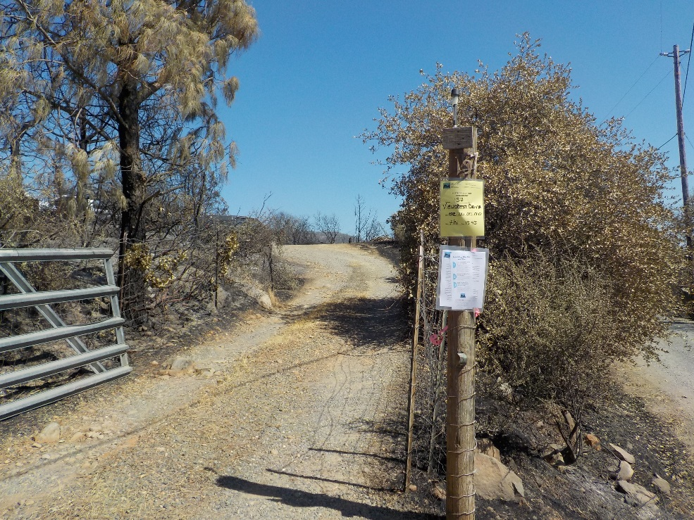
Recovery Process
Step 1
Damage Assessment Teams – coordinate depts.
Step 2
Get information to the fire affected community
Setup Local Assistance Center –
Multi-department team and community resources (PG&E, DMV, SBA) staff for about a week to distribute information and forms, counseling, etc.
Setup Fire Assistance Center –
DROC Team staffs for fire affected residents to drop in and discuss debris cleanup, what is needed for rebuilding, etc. - How to I ……?
Community Meetings –
DROC Team participates in a community meeting within the fire affected area

Slide 6
Goals of the Debris Removal Program
Prevent Pollution from fire debris
Prevent contaminations of wells and water supplies
Documented increases in streams leading into water reservoirs
Arsenic: 3X maximum contaminant level (MCL)
Manganese: 20X MCL
Lead, aluminum, barium, vanadium: all over California MCL
Other contaminants of concern
Residue from batteries, treated wood
Mixture of pesticides, herbicides, garden and home products (unknown reactions)
Polycyclic aromatic hydrocarbons, including dioxins, furans, etc.
Asbestos
PCB’s from appliances, transformers, and automotive parts

Slide 7
Recovery Process – Debris Removal
Forms - completed by property owners
Right of Entry
Bin Program Participation Agreement
Right of Entry Form –
Allows County and State agencies onsite to inspect property for hazardous materials and asbestos
Declaration of Public Health Emergency accomplishes the same thing but can be considered invasive
Bin Participation Agreement
County program provides bins for fire debris removal and waives disposal fee
Acknowledgement in Agreement: If insurance covers, reimburse County

Slide 8
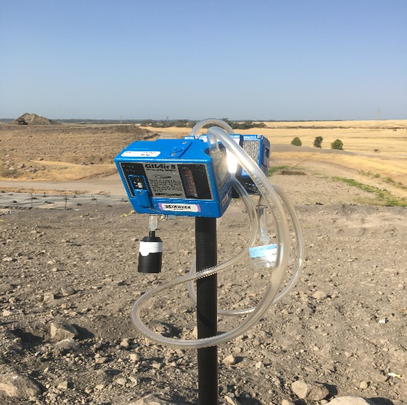
Debris Removal - Preparation
1) Prepare for Fire Debris delivered to landfill
Waiver of WDR requirements applied for and received
Site Specific Health and Safety Plan prepared (I.H.) and air sampling setup
Respirators needed?
Check-in with EH for additional requirements, i.e. asbestos handling plan
Check transportation requirements with local AQMD, possible NESHAP.
BOS Waiver of fees?
2) County contracts with haulers to provide bins at “cleared” property
If seeking State reimbursement, bins must be in right of way
3) County EH and DTSC inspect property, removal hazardous waste, and “clear” property for debris removal
4) If using OES / CalRecyle – they coordinate and contract debris removal

Slide 9
Butte County Debris Removal Flow Chart
 |  |  |  |  |  |  |  |  | Debris
 |  |  |  |  |  |  | Right of Entry - Yes |  |  |  |  | Right of Entry - No
 |  |  | Bin Participation Agreement - Yes |  |  |  | Bin Participation Agreement - No |  |  | Private HW Assessment / Removal |  |  | No HW Assessment / Removal
 | Owner has Insurance |  |  | No Insurance/Under |  |  | Owner hires contractor |  |  | Owners contacts Debris Coordinator |  |  | Code Enforcement Action
 | Owner hires contractor |  |  | Debris Coordinator Authorizes Bin Program |  |  | Debris Coordinator waives LF fee |  |  | Debris Coordinator authorizes disposal
 | Debris Coordinator approves for LF |  |  | Owner contacts County for bin delivery |  |  | OK to Landifll; LF Fees Waived |  |  | OK to Landifll, Owner pays LF Fees
 | OK to Landfill; LF Fees Waived |  |  | OK to Landfill; LF Fees Waived |  |  | Owner submits self-certification form Debris Removal |  |  | Owner submits self-certification form of Debris Removal
 | Owner submits self-certification form Debris Removal |  |  | Debris Coordinator verifies Debris Removal
 |  |  |  | Letter of Completion sent

Slide 10
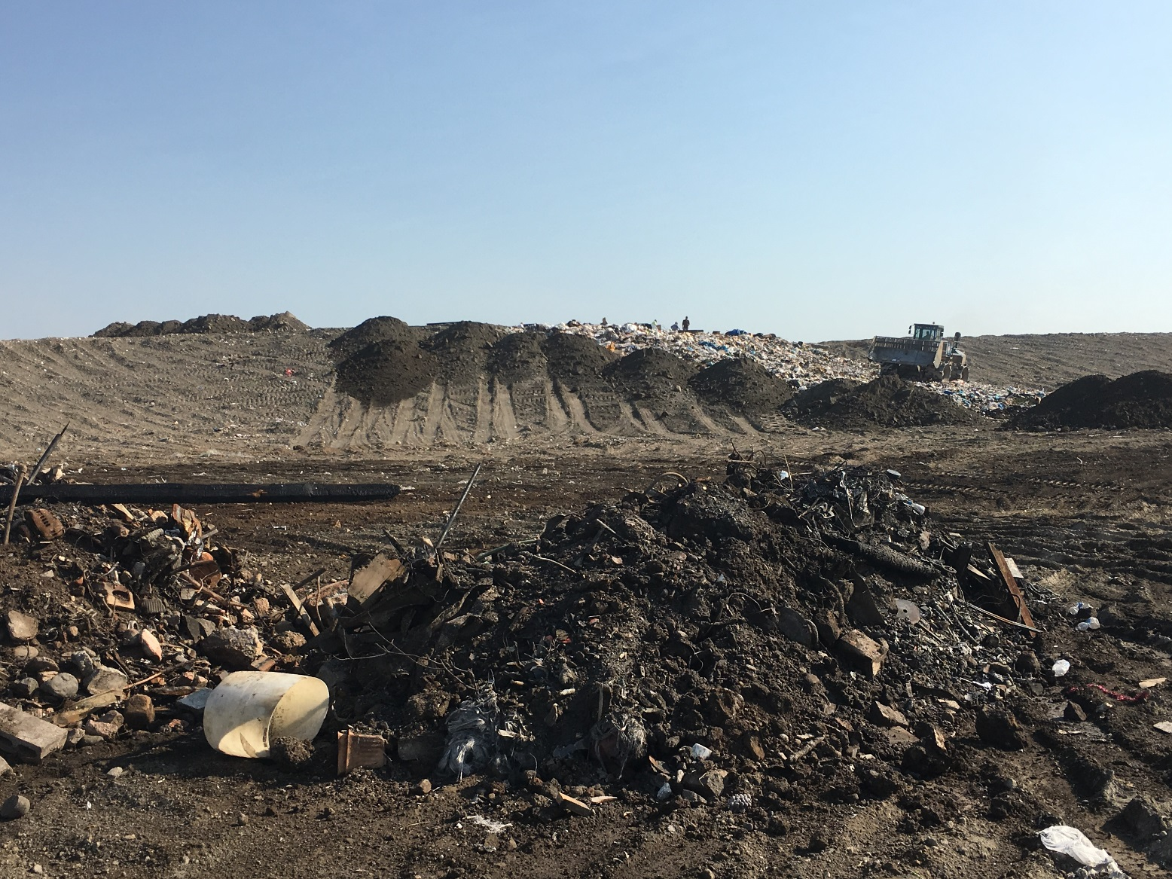
Fire Debris Disposal – BMPs
Isolate fire debris
Wet fire debris to control dust
Cover at the end of the day (with care)
Advance cell to waterfall trash over the top
Minimize disturbance
Record Grid coordinates

Slide 11
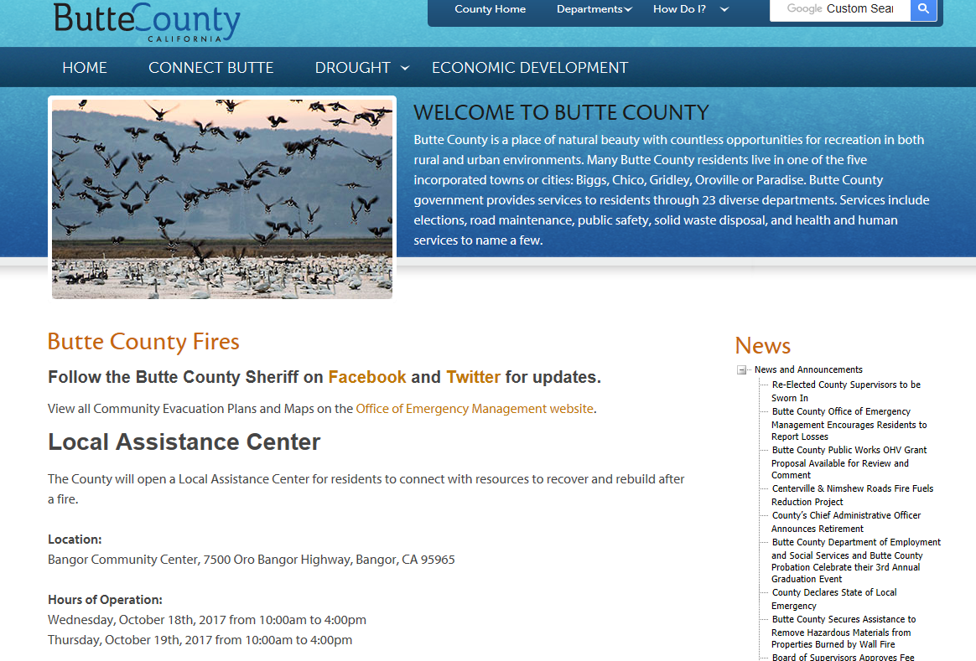
Need More Information?
www.buttecounty.net
Bill Mannel 879-2350
bmannel@buttecounty.net
Steve Rodowick 879-2352
srodowick@buttecounty.net
Eric Miller 879-2351
emiller@buttecounty.net

