Slide 1
Contaminated Oil Claims
ESJPA 2016
Marcie Whitlow
Emily Wang

Slide 2
Who is eligible?
Certified Collection Centers
Curbside Collection Program
Publicly funded collection center in small rural county

Slide 3
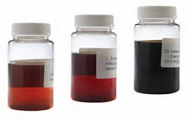
What can be reimbursed?
Testing
Disposal
Clean-up

Slide 4
How much can be reimbursed?
PCB – net additional costs
Halogens – up to $5,000 of net additional costs

Slide 5
Other limits
CalRecycle funding limit - $200,000/yr
One shipment per year
Contaminated oil prevention procedures

Slide 6
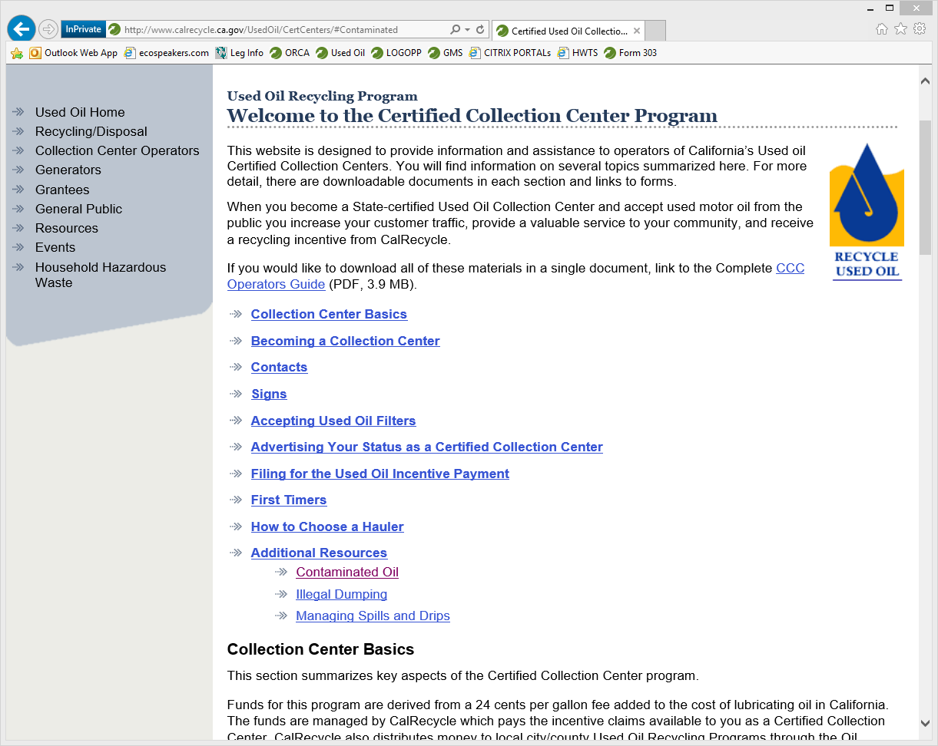
http://www.calrecycle.ca.gov/UsedOil/CertCenters/

Slide 7
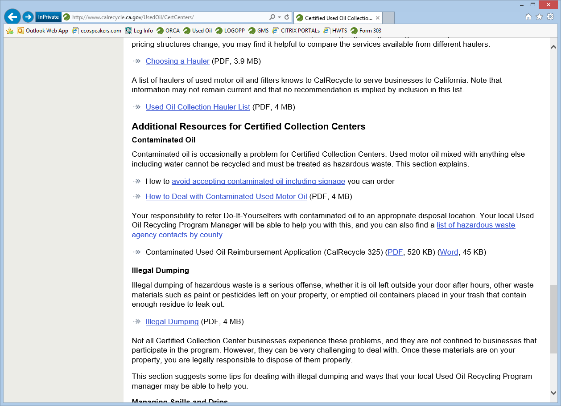

Slide 8
Claim Documentation
Lab tests
Manifests
Copy of contaminated oil prevention procedures
Invoices

Slide 9
References
Statute: PRC 48660.5
Regulations: Title 14, §18651.8

Slide 10
Questions?
Marcie.Whitlow@CalRecycle.ca.gov
916-341-6294
Emily.Wang@CalRecycle.ca.gov
916-322-2888
Notes:
Questions?

