Slide 1
Mattress Recycling Program: ESJPA Rural County Update
June 23, 2016
Liz Wagner – Territory Representative

Slide 2
Program To Date
Over 110 Collection locations in CA – SWF & Retail
10 One-day collection events
11 primary recycler locations
Over 320,000 mattresses collected to date

Slide 3
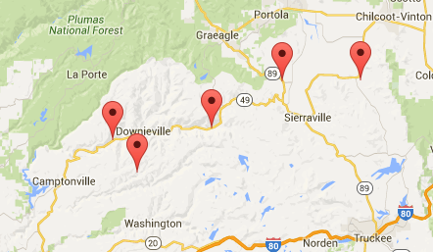
Moving Forward

Slide 4
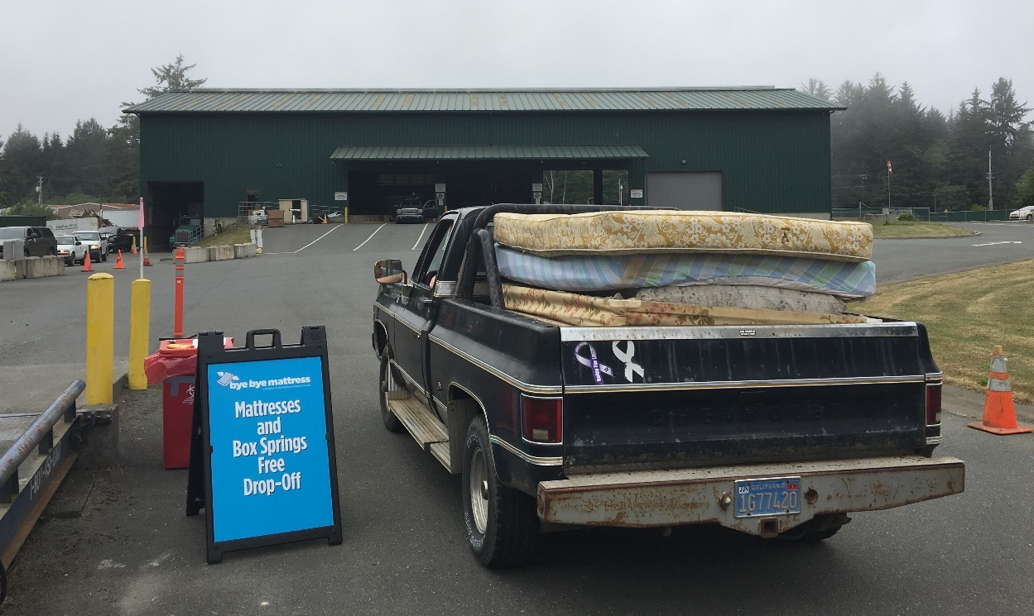
Del Norte Collection Event

Slide 5
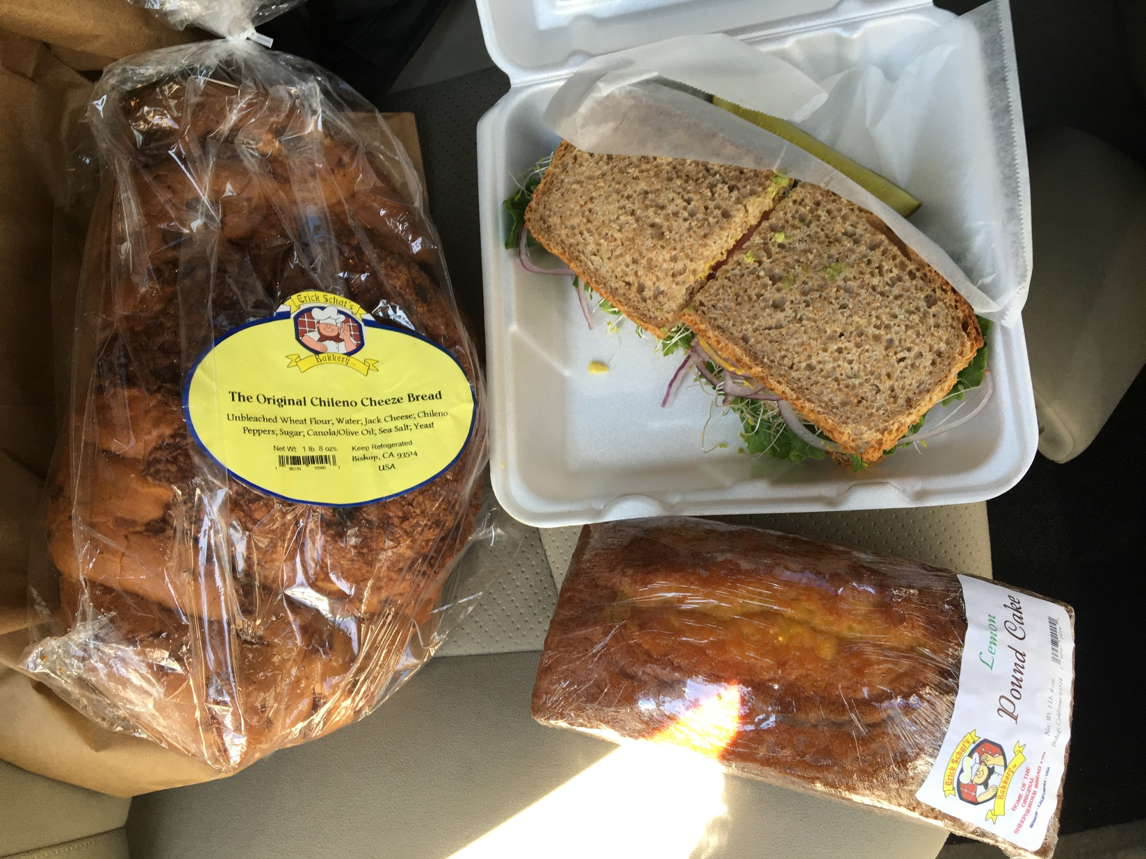
Inyo County

Slide 6
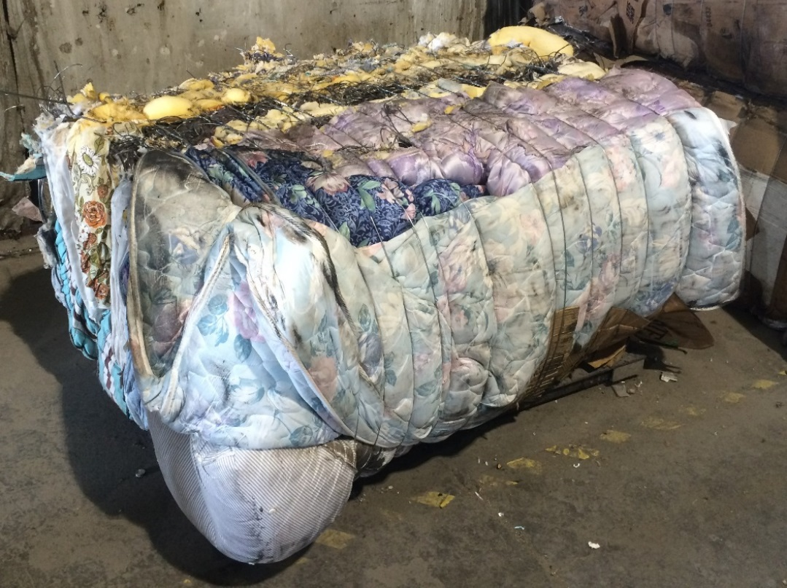
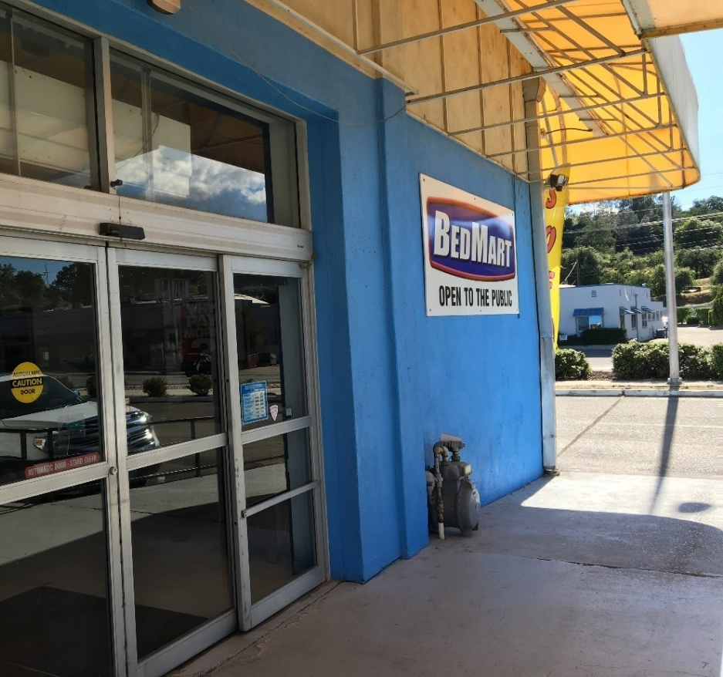
Mattress Baling
Retail Collection Locations

Slide 7
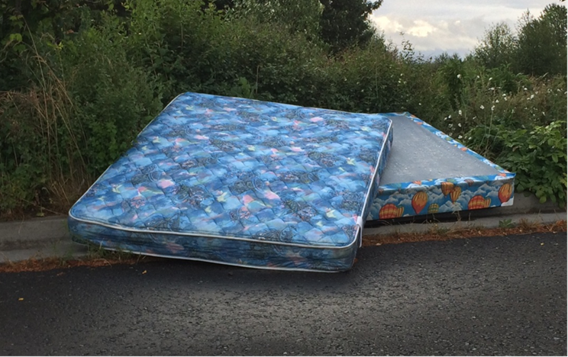
Illegal Dumping Payment Program (IDPP)
Offset costs to clean-up illegally dumped mattresses
Reimburse up to $10 per mattress collected
$750,000/# of units = $ per unit paid
Data collected will establish baseline

Slide 8
IDPP: Eligibility & Registration
Eligible Entities
Local Government
Solid Waste Facilities
Franchise haulers
Non-profits contracted w/ municipalities
JPA’s
Tribes
Register: https://connect.re-trac.com/registration/mrc-idp

Slide 9
IDPP: Reporting
Each pick-up requires data entry of:
# of units collected
Zip code
End disposition of units: Recycled or landfilled
To date:
54 registered
Over 4,000 mattresses reported

Slide 10
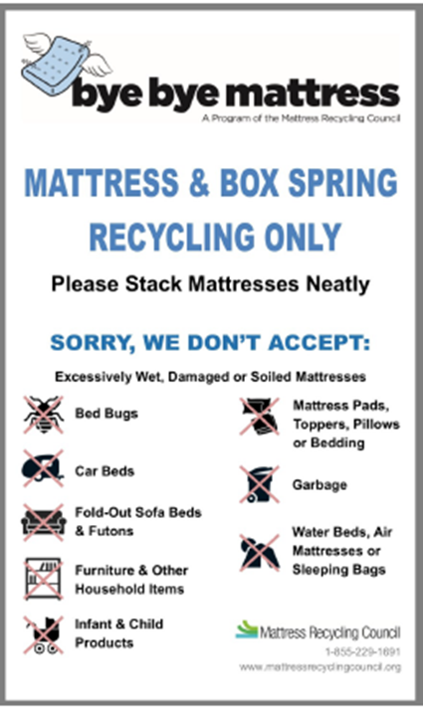
Collection Site Signage Coming Soon

Slide 11
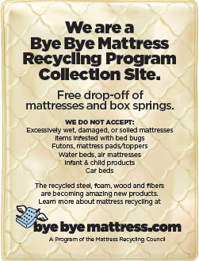
SWF Info Cards

Slide 12
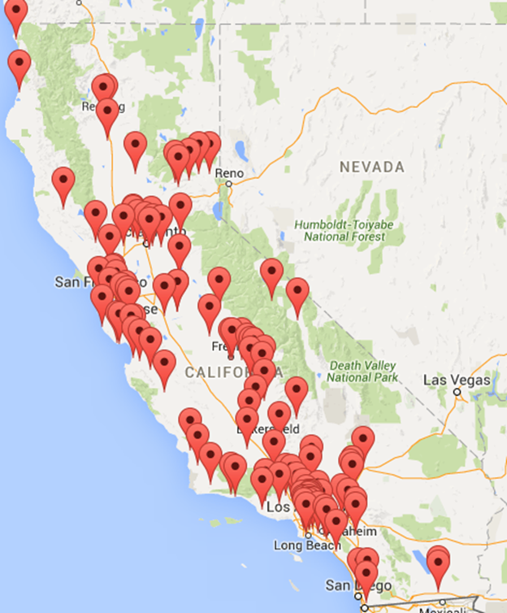
Locator Tool Improvement

Slide 13
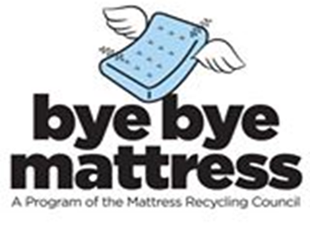
Questions?
Mattress Recycling Council: www.mattressrecyclingcouncil.org
ByeBye Mattress (consumers): www.byebyemattress.org
Liz Wagner
(916) 798-1594
lwagner@mattressrecyclingcouncil.org

